Slide 1
Premier League 2021-22 Season Analysis System
CS-GY 6083 Principles of Database Systems
By: Gautam Suresh Nambiar (gsn2012)
Sourabh Kumar Bhattacharjee (skb5275)
12.16.22

Slide 2
Introduction
Premier League - first-division soccer league of the United Kingdom. 20 teams, 380 matches. 1 winner, 3 relegations.
Premier League Analysis System - a simple and easy-to-use database management system designed to analyze the data for the 2021-22 season of the league.
Purpose –
Useful Insight Generation tool
Can be used by Sports Analysts
Answers questions related to Teams, Players, Managers, Stadiums, Referees and Goals

Slide 3
Data Gathering
Data has been sourced from the following:
Official Website of English Premier League Fantasy Football
Kaggle
Soccerstats Website
Contains details for 380 matches, 20 Teams, 653 Players, and more

Slide 4
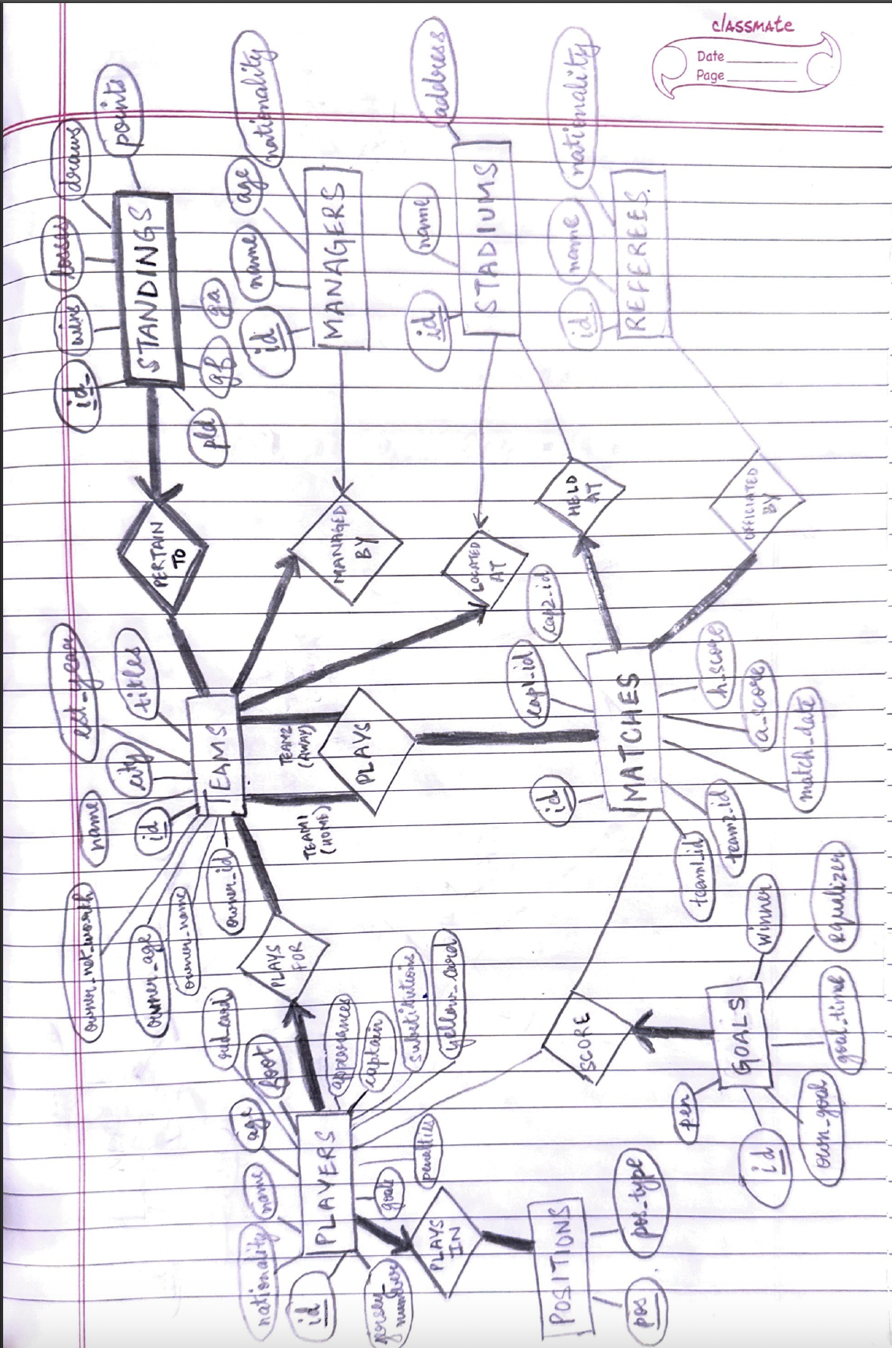
ER Diagram

Slide 5
Application Demo
We’ll give an overview of the application and some selected functionalities through screenshots in the following few slides.

Slide 6
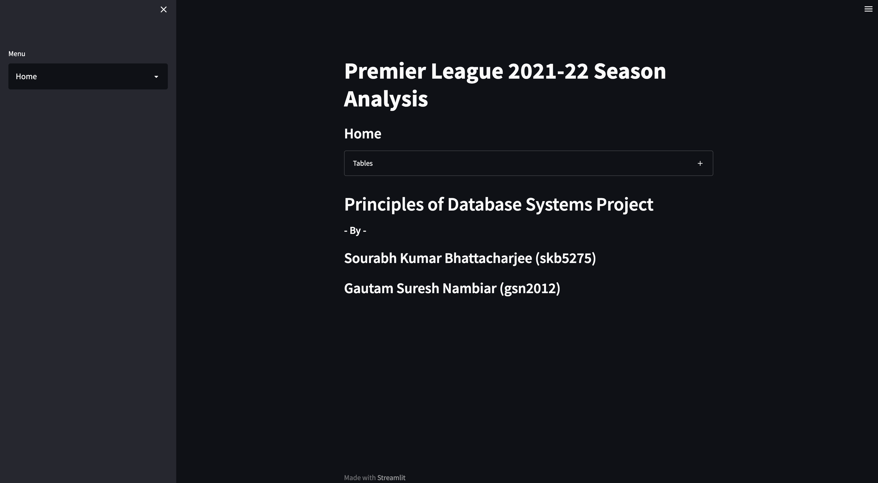
Homepage
Main Menu Dropdown
Option to look at each table in the database

Slide 7
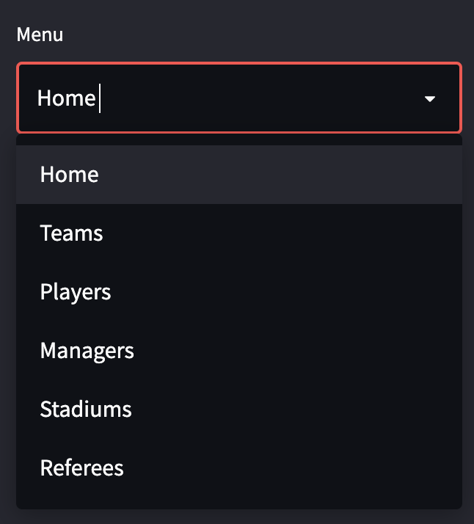
Main Menu
6 levels of abstractions based on Entities
Each abstraction contains
Further drill-downs
Answers to question related to abstractions

Slide 8
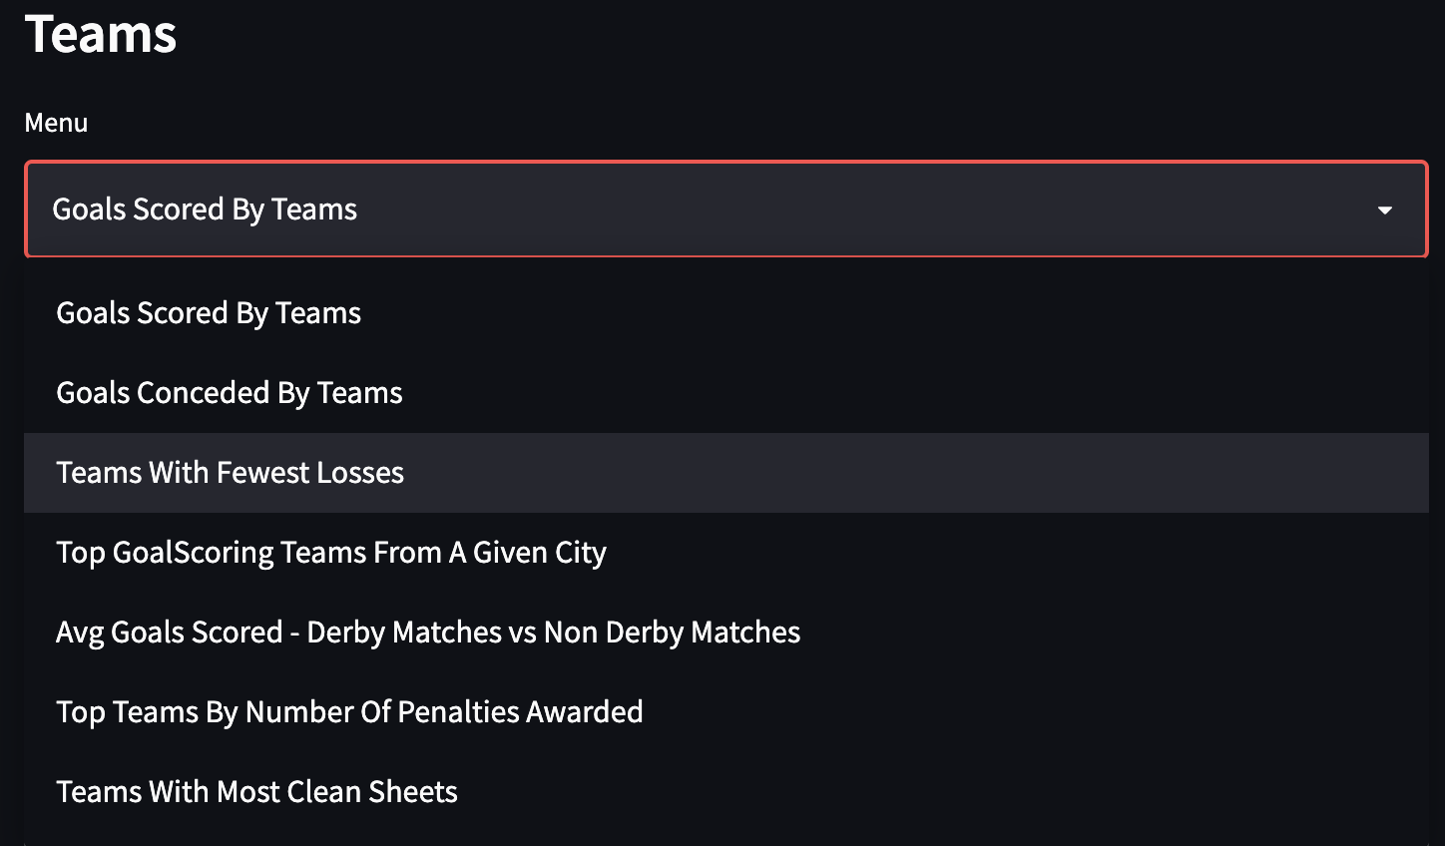
Teams – Query Dropdown

Slide 9
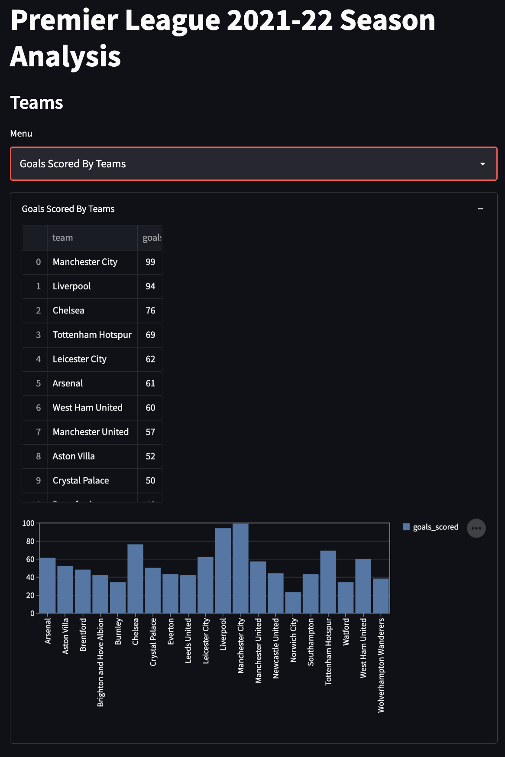
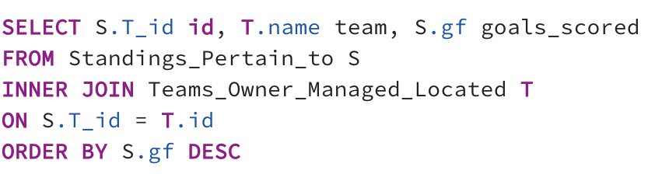
Teams – Goals Scored by Teams
Total goals scored by each team in descending order?
Query:

Slide 10
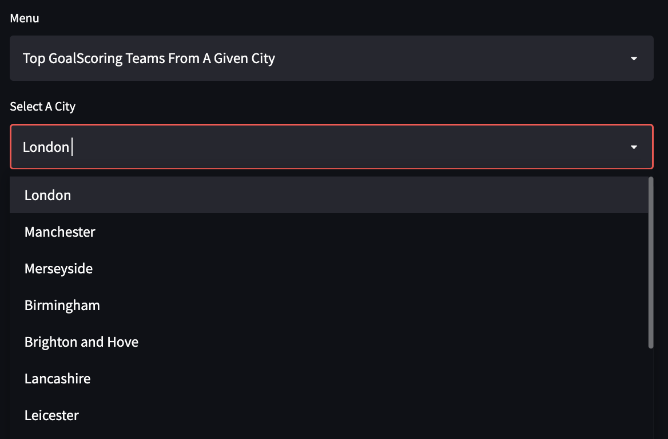
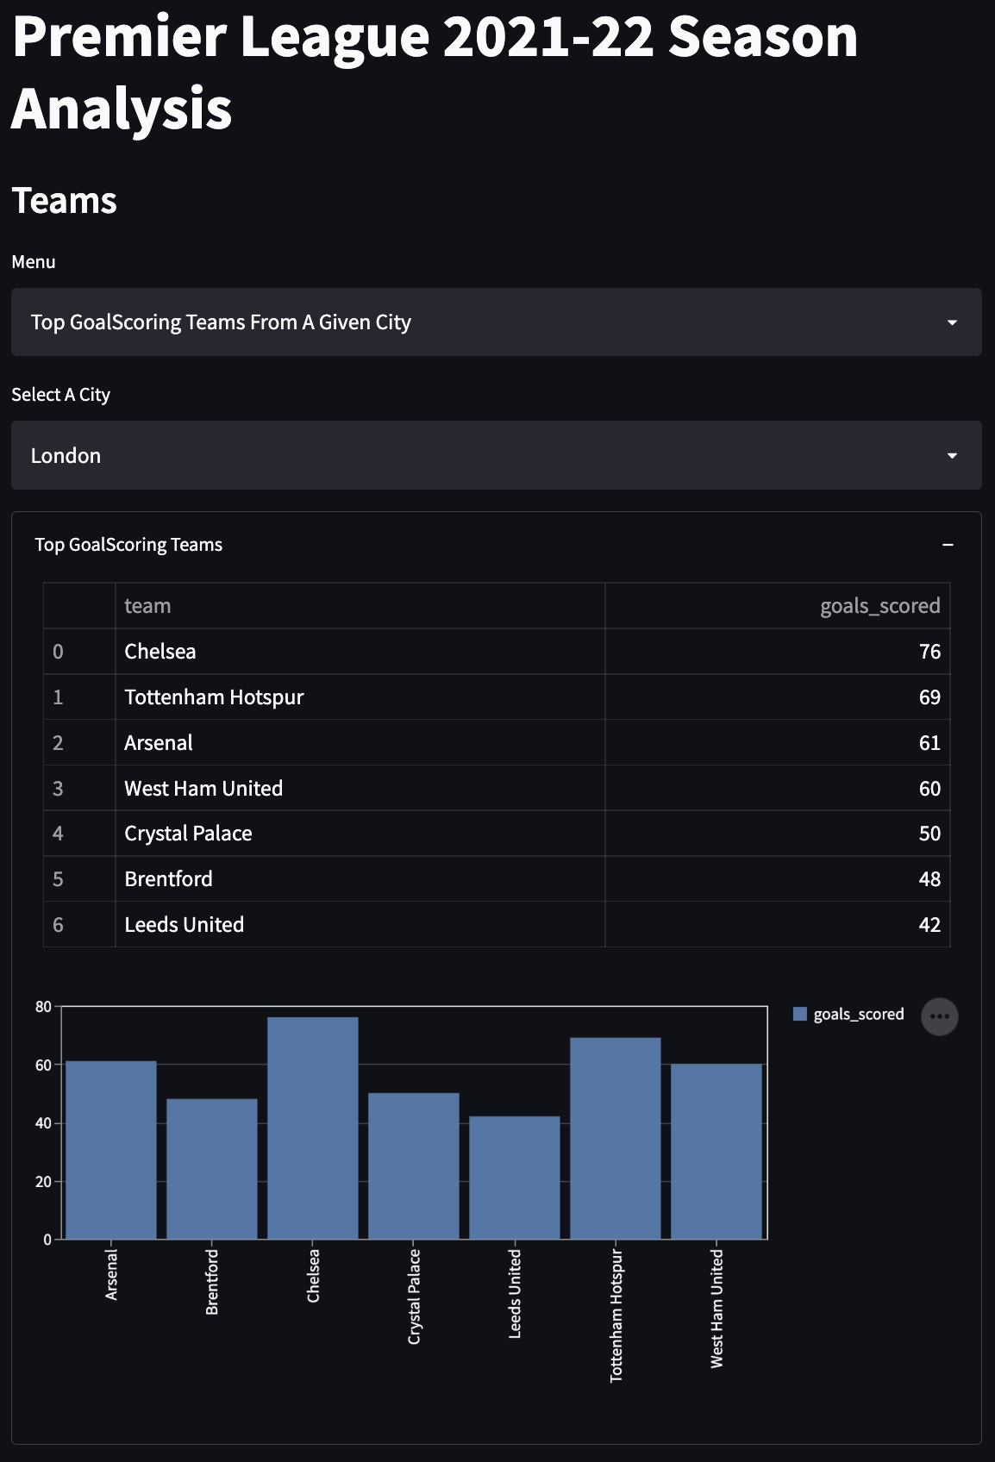
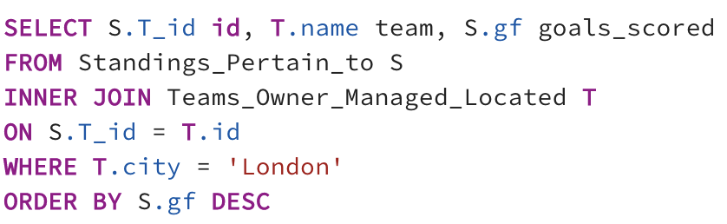
Teams – Top Goal Scoring Team by City
Which teams from a given city are the top goal scorers?
Query:
Option to select City from dropdown

Slide 11
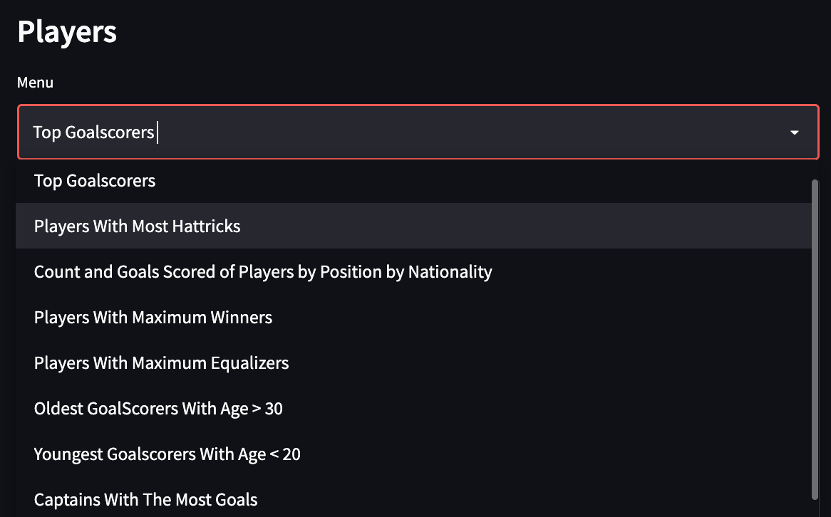
Players – Query Dropdown

Slide 12
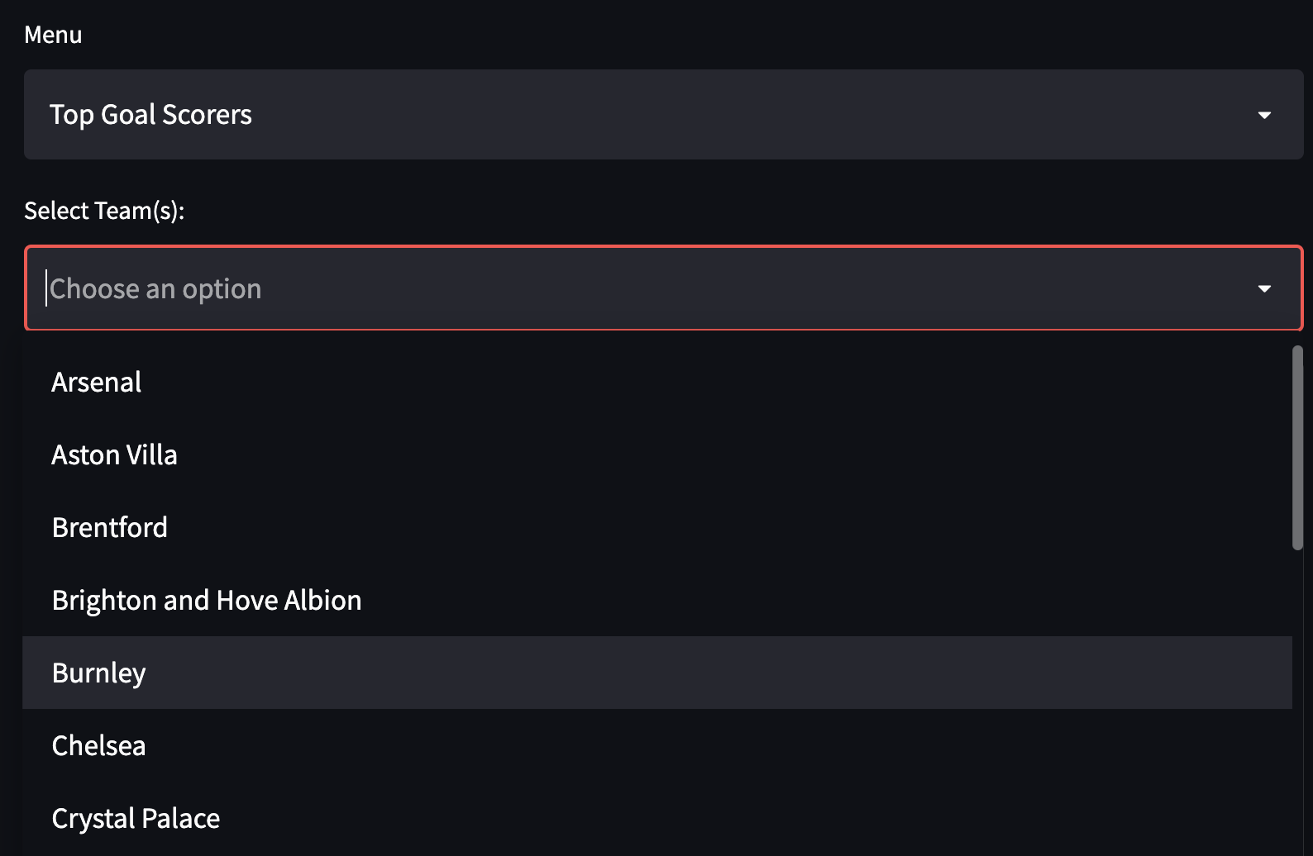
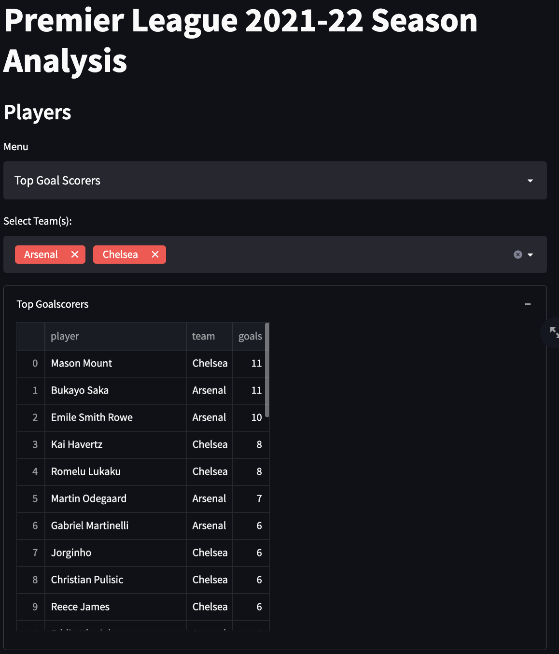
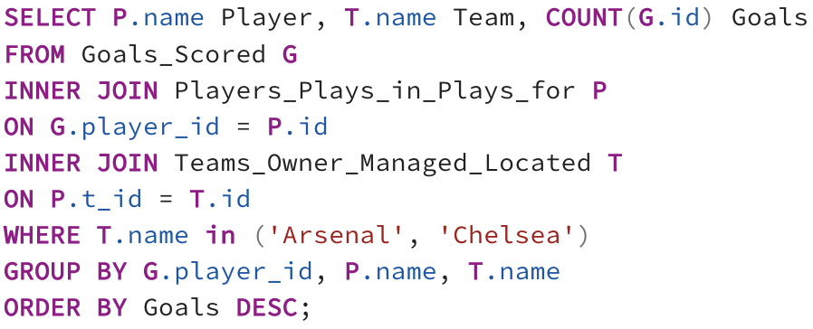
Players – Top Goal Scorers
Which players have scored the most goals (for any subset of teams)?
Query:
Multi-Select Dropdown to select None or any subset of Teams

Slide 13
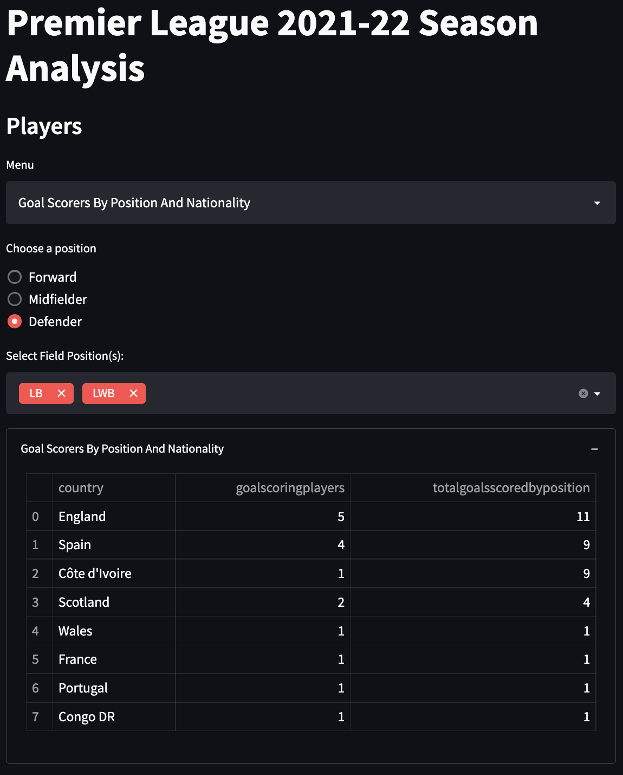
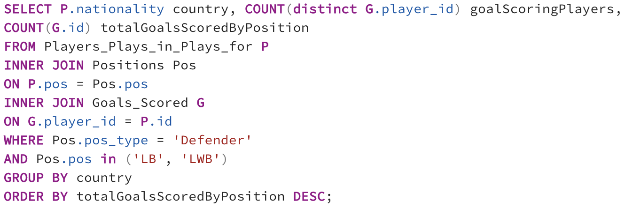
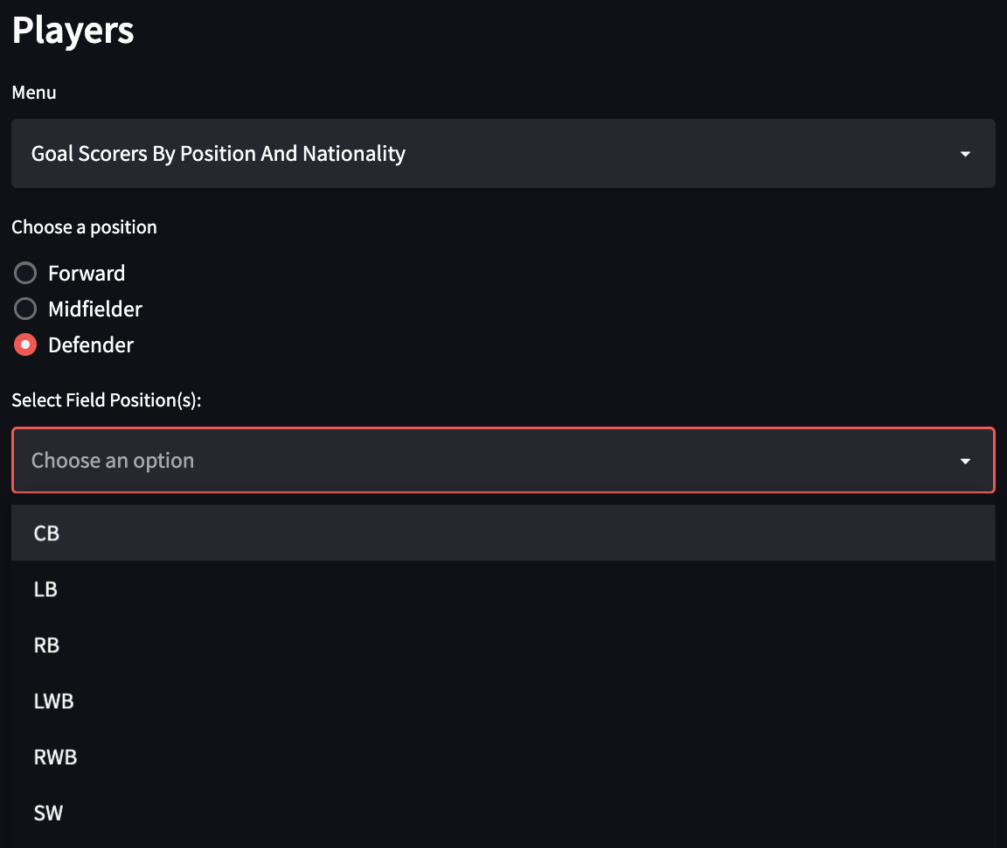
Players – Goal scorers by Position and Nationality
Which nation produces the most goal scoring forwards / midfielders / defenders?
Query:
Radio Button to select Position
Conditional Multiselect Dropdown to select Field Positions depending on the Radio Button above

Slide 14
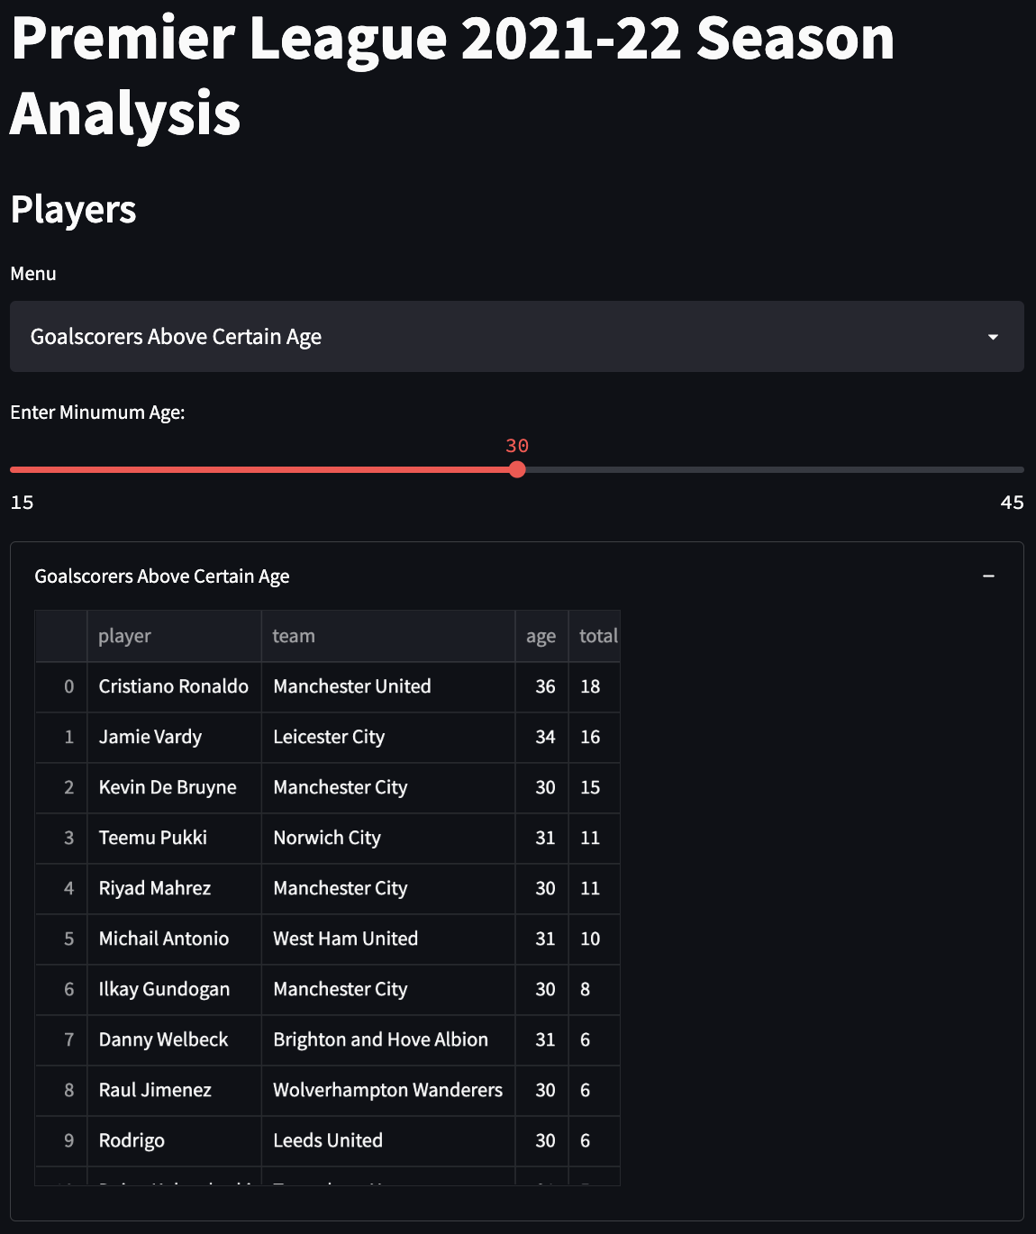
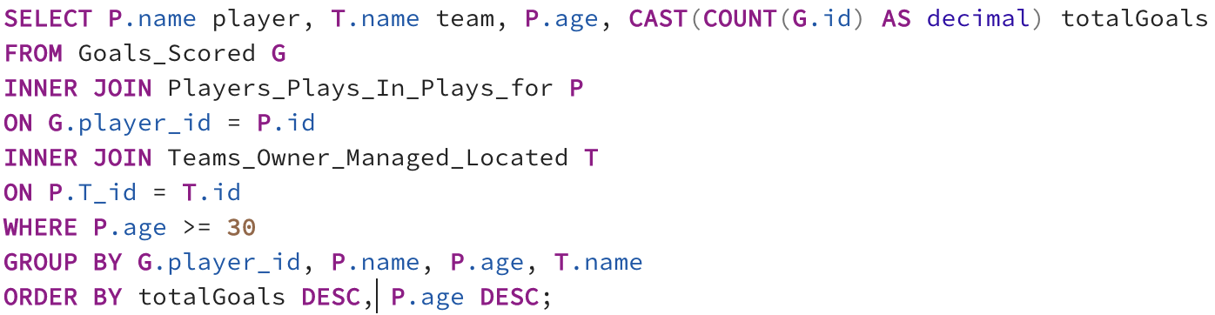
Players – Goal Scorers Above Certain Age
Who are the top goal scorers above a certain age?
Query:
Numeric Slider to take Age as input

Slide 15
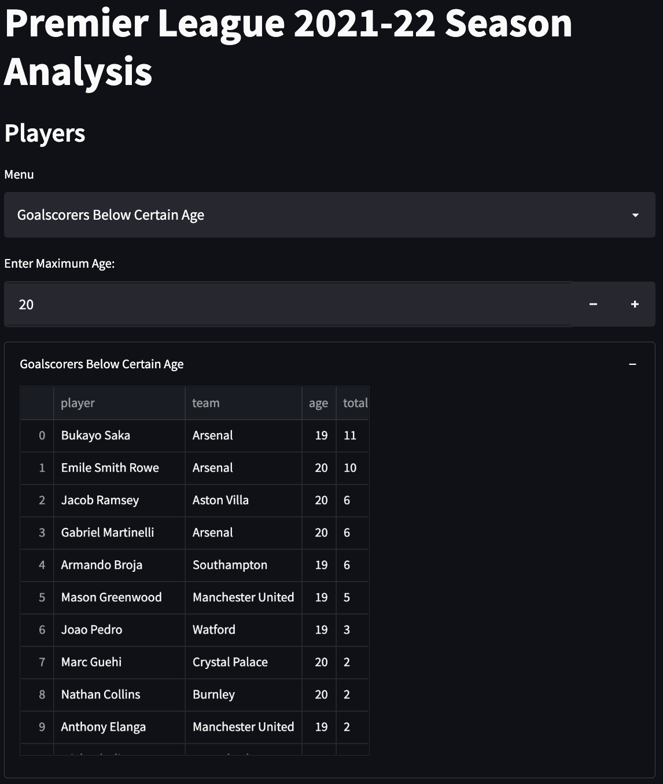
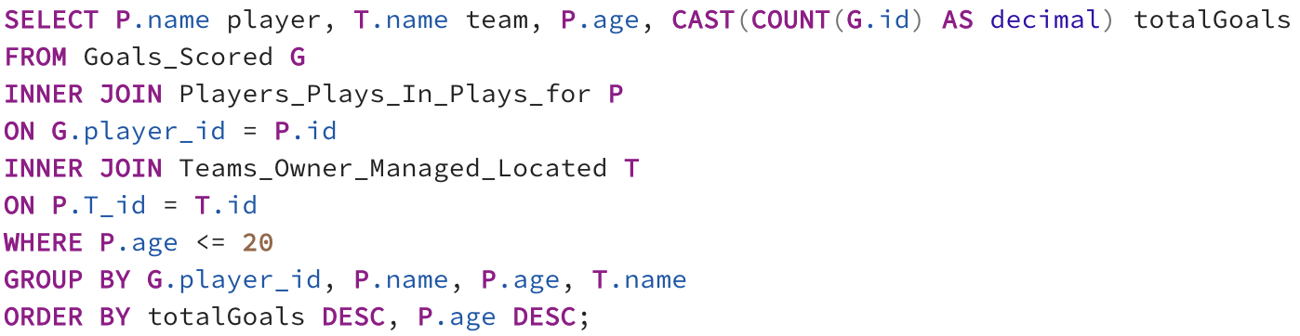
Players – Goal Scorers Below Certain Age
Who are the top goal scorers below a certain age?
Query:
Number Input Box to take Age as input

Slide 16
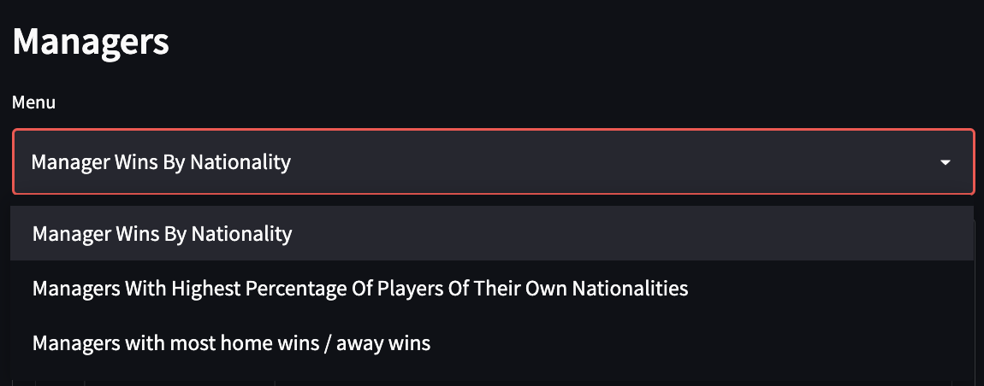
Managers – Query Dropdown

Slide 17
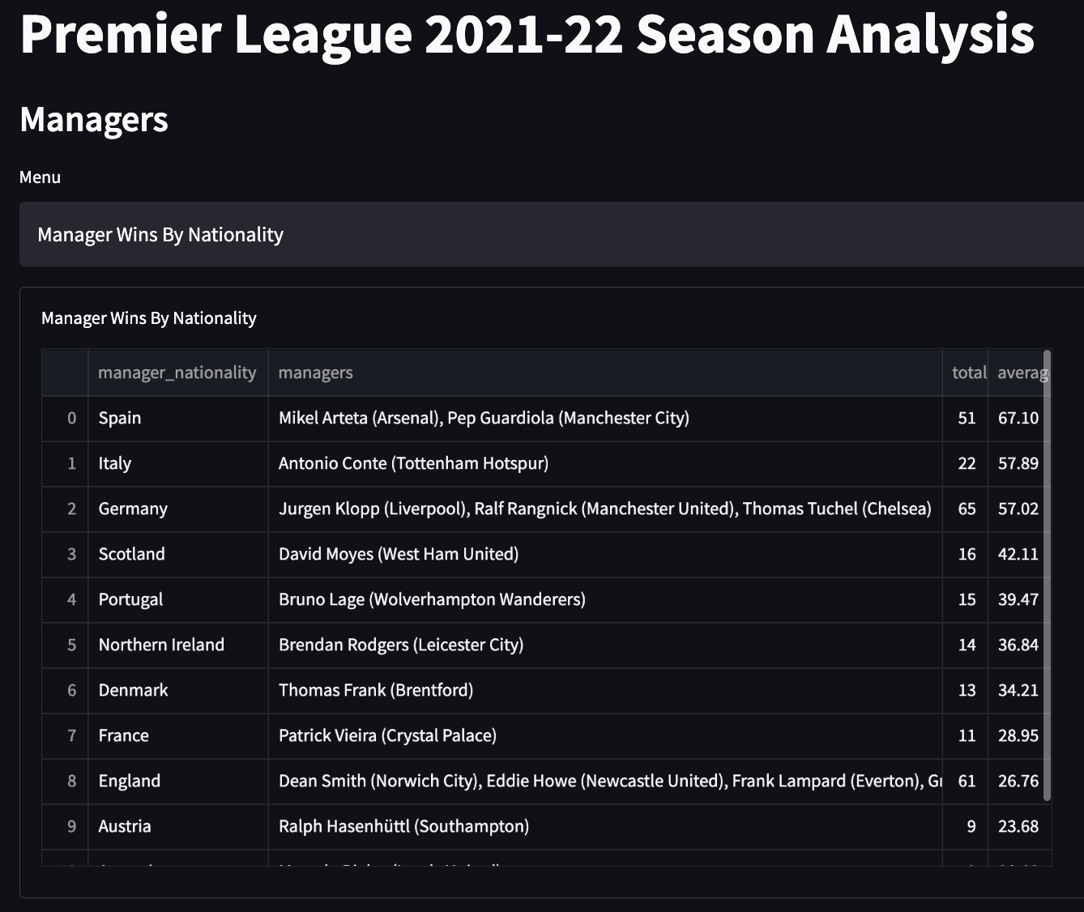
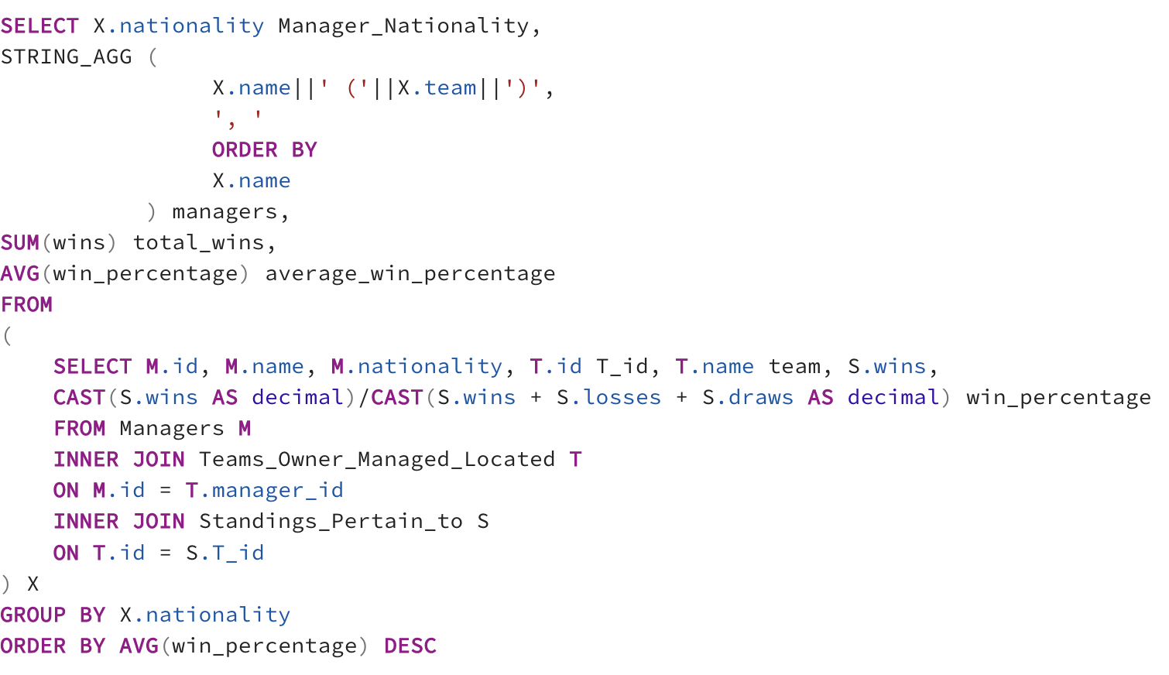
Managers – Managers Wins by Nationality
Which nationality produces managers with the highest win percentages?
Query:

Slide 18
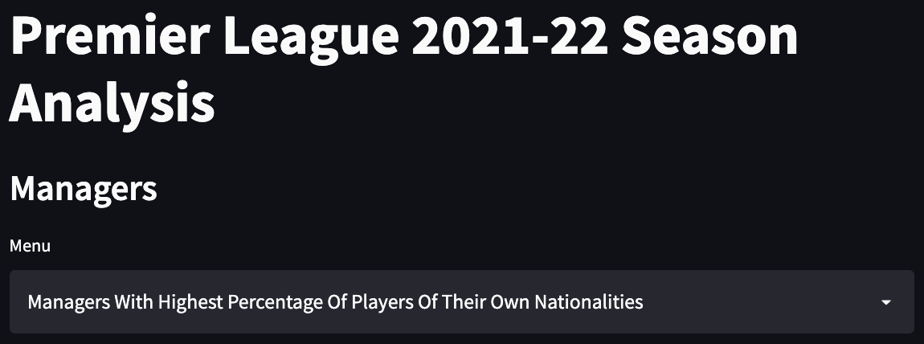
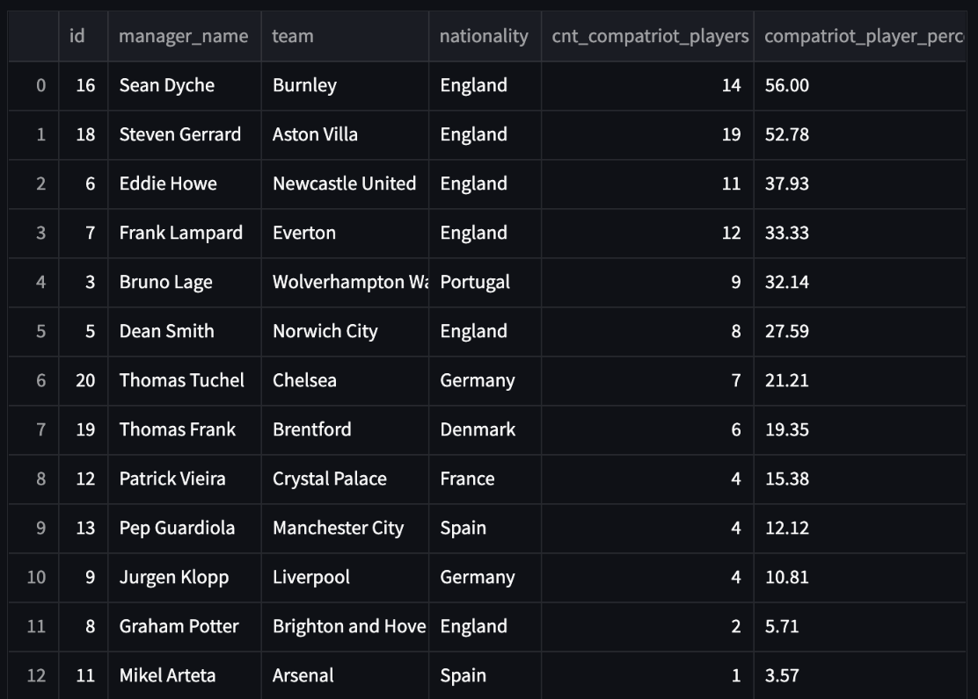
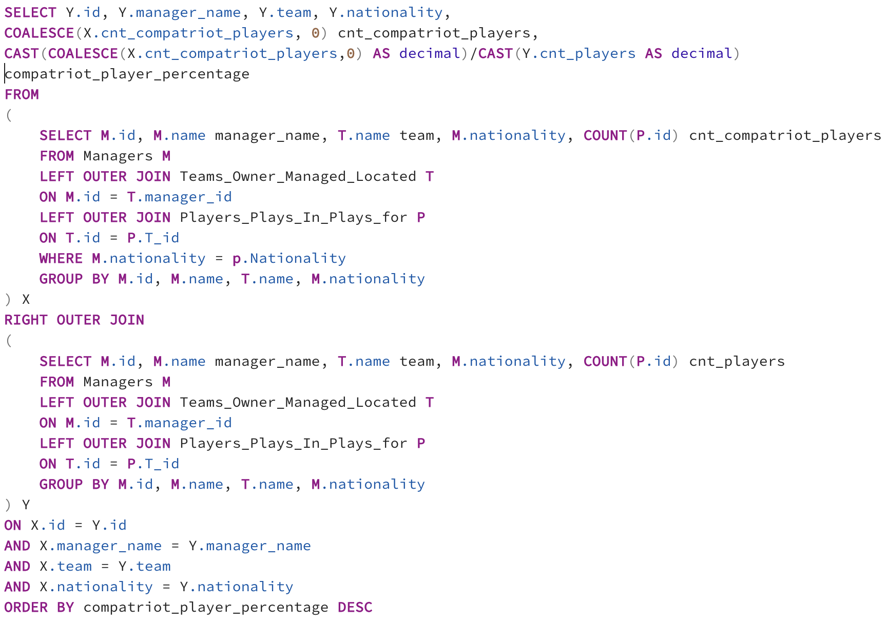
Managers – Highest % of players from their own Nationality
Which managers squad contains the highest percentage of players from his own country?
Query:

Slide 19
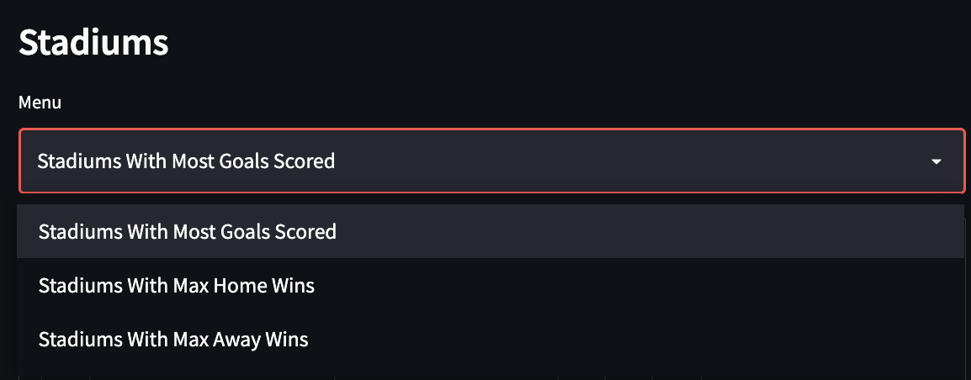
Stadiums – Query Dropdown

Slide 20
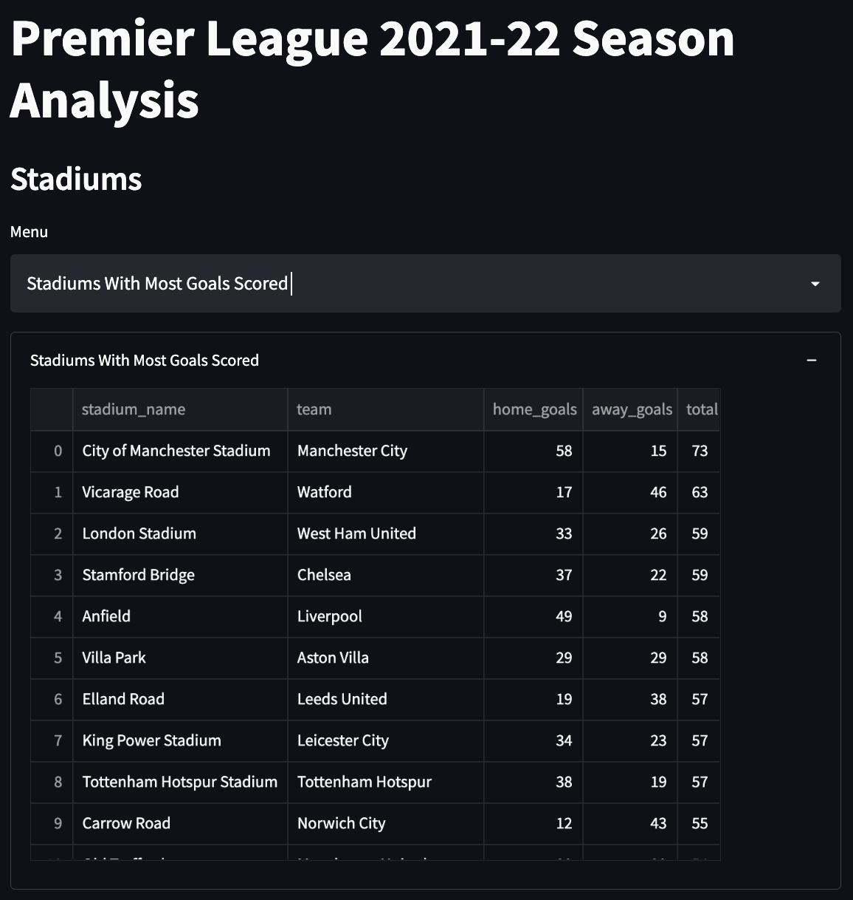
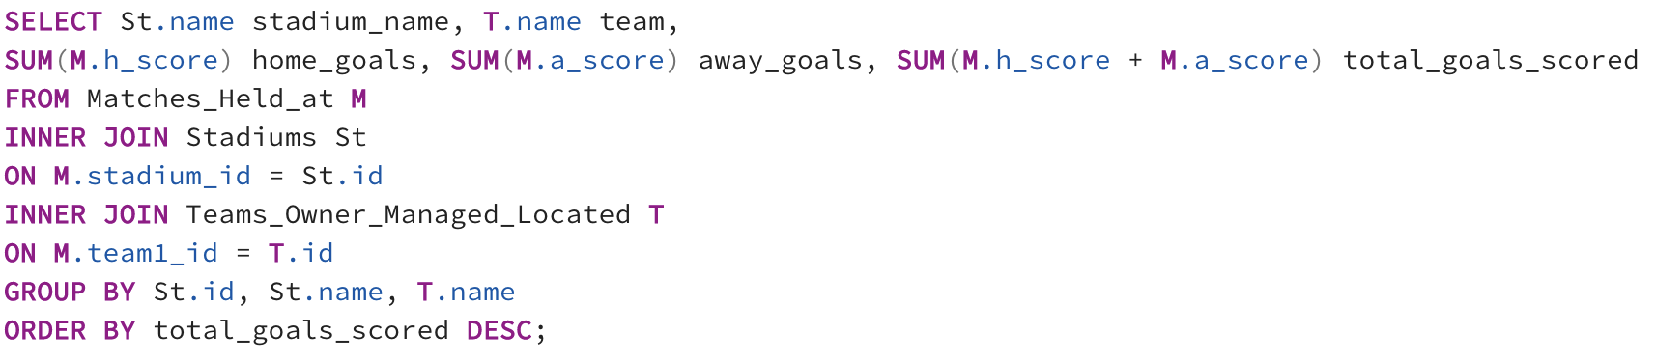
Stadiums – Most Goals Scored
Which stadiums had the most goals scored in them?
Query:

Slide 21
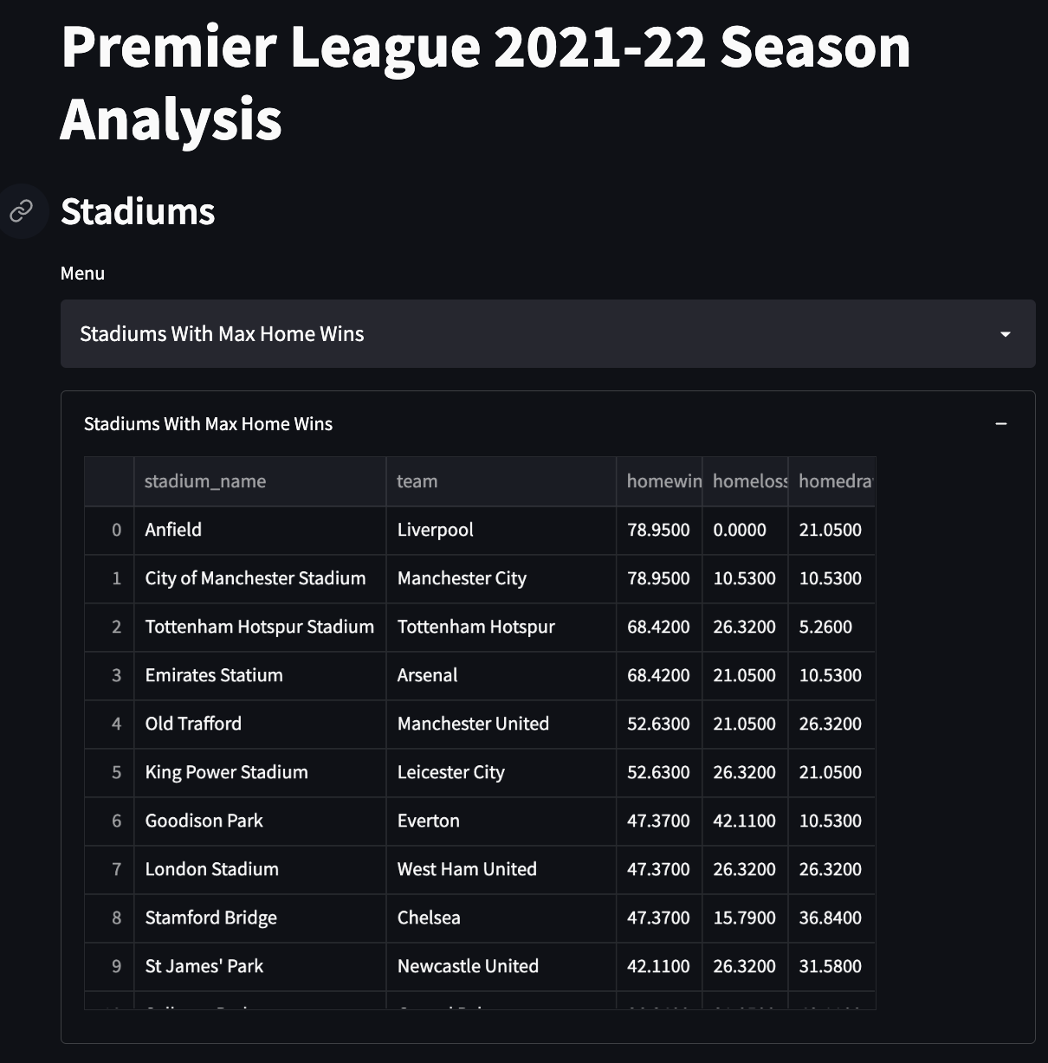
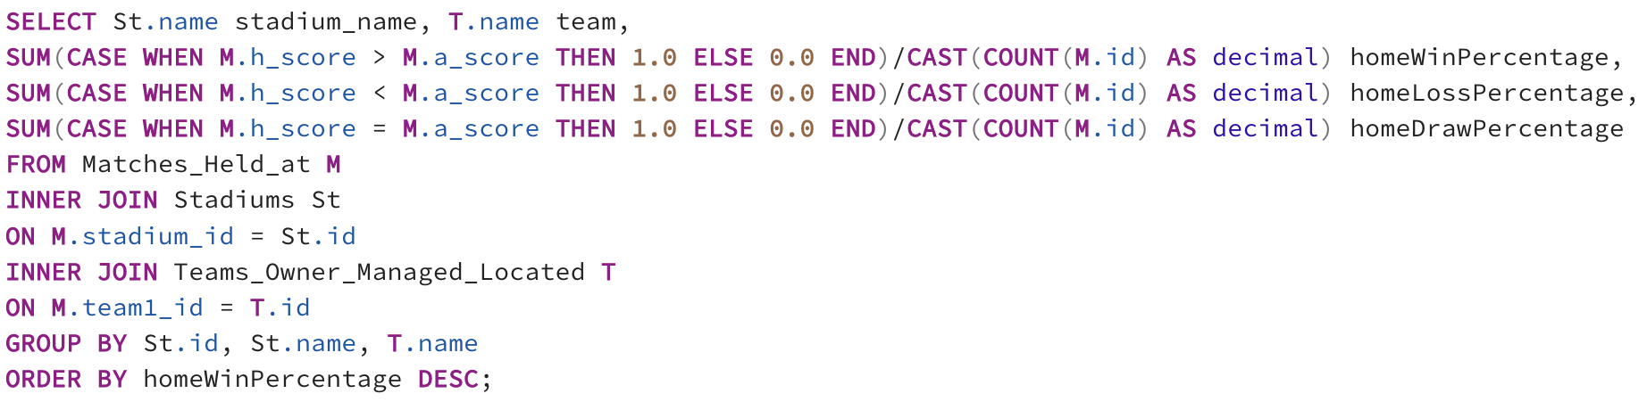
Stadiums – Maximum Home Wins
Which stadiums were such that the home team won the max number of times?
Query:

Slide 22
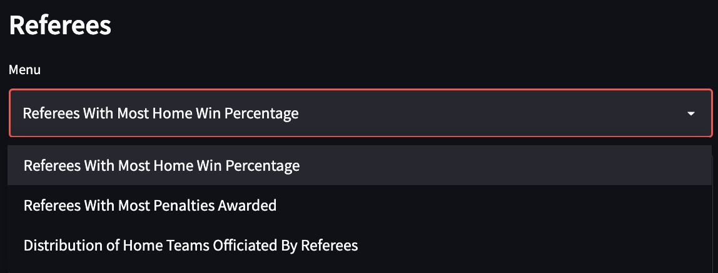
Referees – Query Dropdown

Slide 23
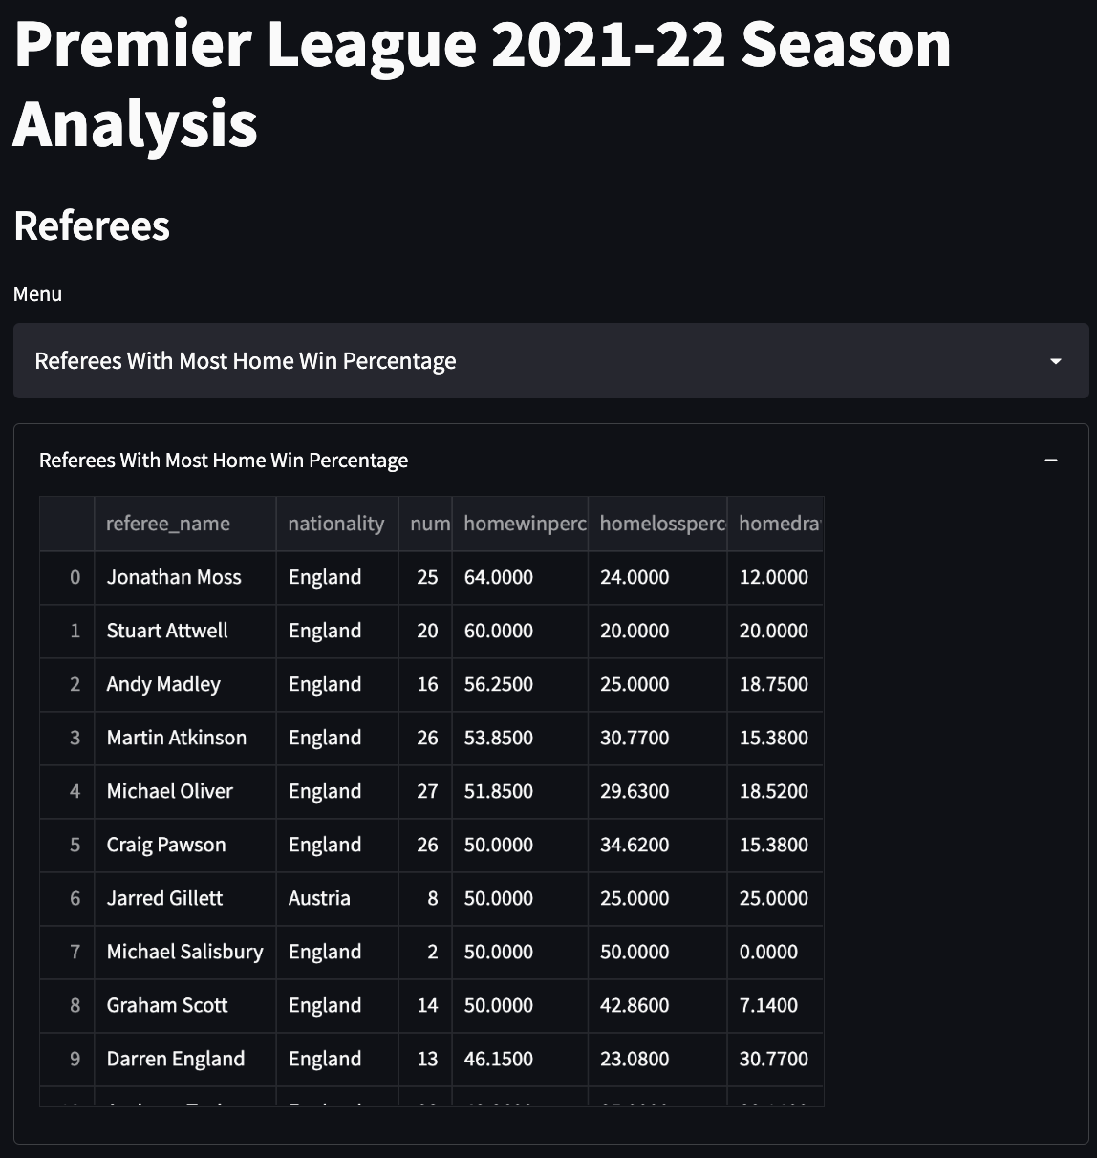
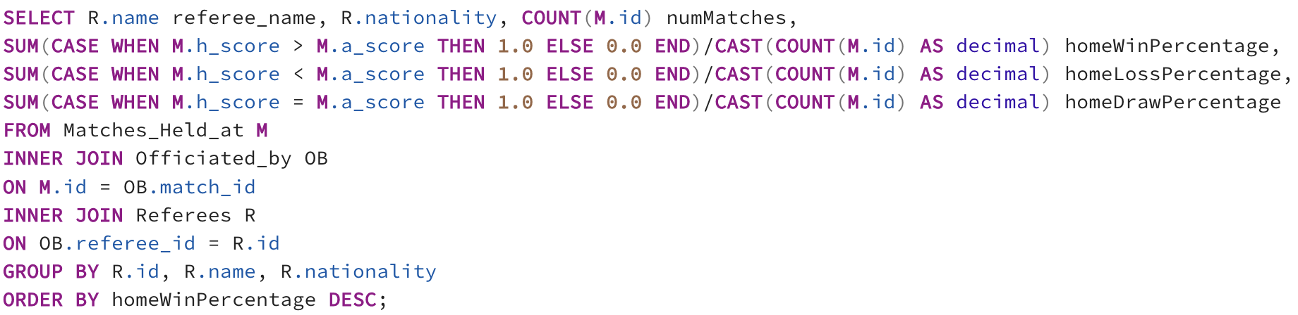
Referees – Officiating Most Home Wins
Which referees have officiated matches where the home team has won?
Query:

Slide 24
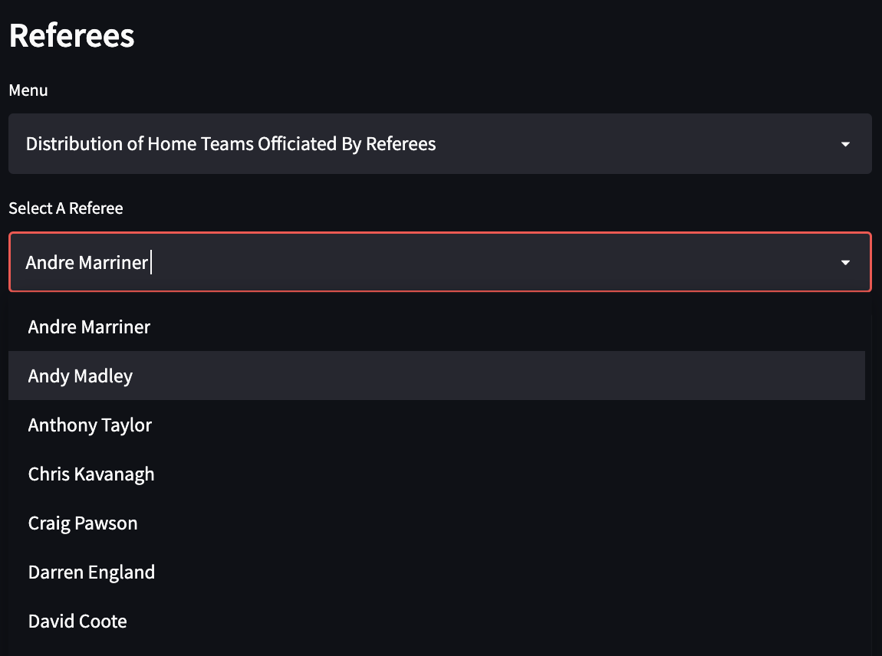
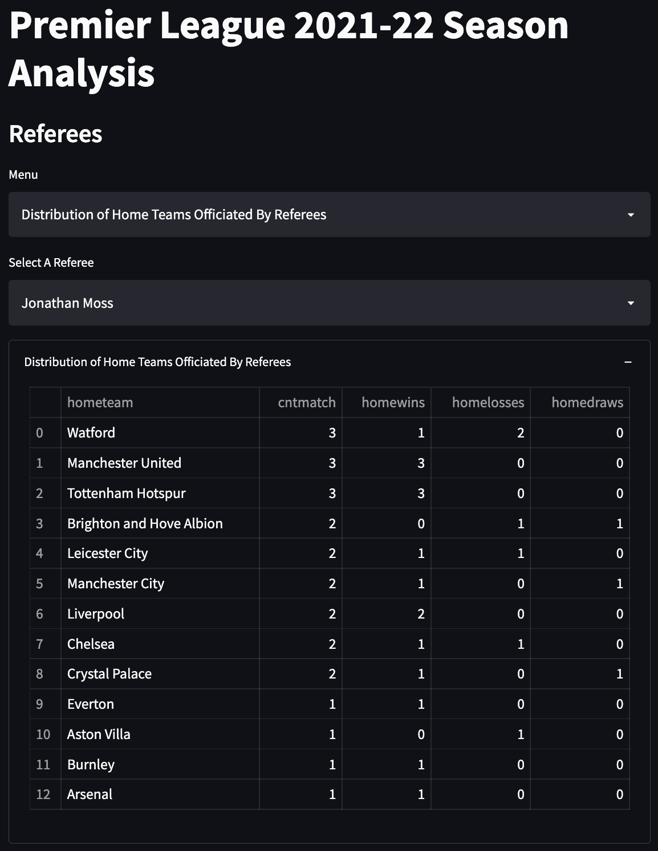
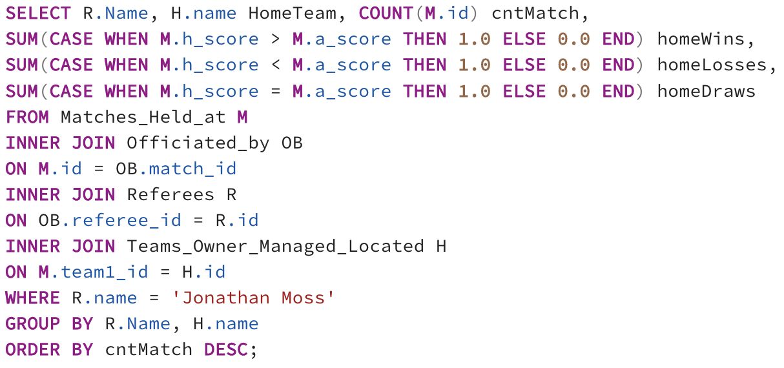
Referees – Distribution of Home Teams officiated
What is the distribution of the home teams officiated by some given referee, and their respective results?
Query:
Dropdown to select Referee from Dropdown

Slide 25
Go check it out for yourselves!
Here

Slide 26
Thank You!

